Slide 1

Personal Assistance Device for Independent Senior Citizens done by
ANAND KUMAR(18481A0221)
SALAM(19485A0217)

Slide 2
Abstract
Tracking the health of a person and proper medication improves their life time. Studies suggest the most of the deaths of the elderly people have occurred during the night when the person is asleep. A Caretaker cannot assist a person all the time. This work proposes a personal assistant for an elderly people or a patient. The Personal assistants can provide in-home respite care, allowing family members or other caretakers to take a temporary break. The main objective of this work is to help seniors maintain their quality of life at home and to keep them living their lives their way, as well as to lighten the load of full-time or family caretaker.

Slide 3
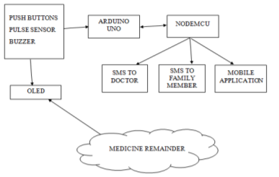
BLOCK DIAGRAM

Slide 4
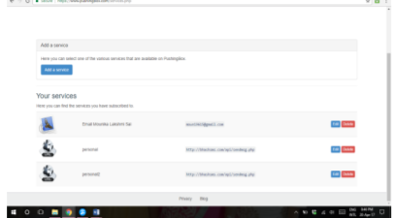
WORKING OF PERSONAL ASSISTANT DEVICE
When the elderly wear the device, the pulse sensor present in the device measures the pulse rate, later these readings are sent to the Arduino-uno. The data from different sensors are sent to the Arduino and through NodeMCU.These measured values are sent to the doctor application and then the caretaker can check the readings frequently. If the patient does not know how to use the mobile then the device has some push buttons just by pressing them the alert is sent to the doctor or caretakers mobile application.

Slide 5
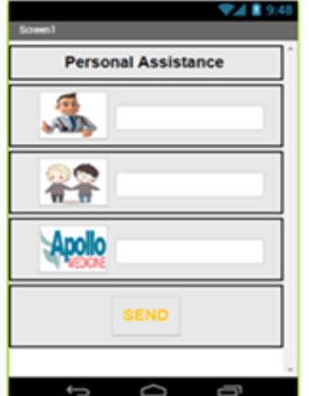
MOBILE APPLICATION

Slide 6
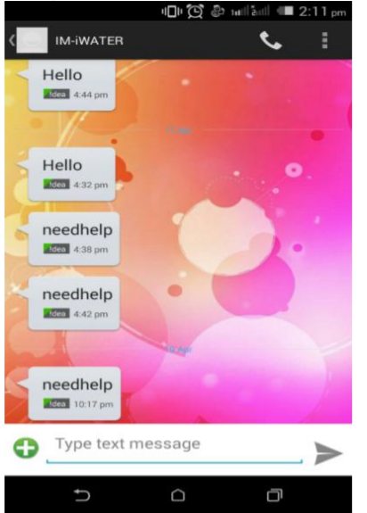
Result

Slide 7
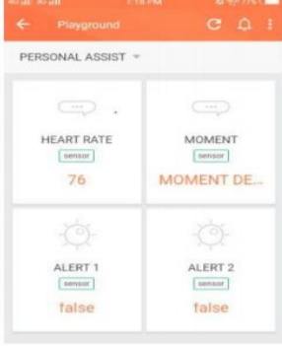

Slide 8
Conclusion
With the continuously increasing utilization of internet in this point in time, this assignment paintings has been engaged to execute a framework depending on web innovation which could discuss through internet for health checking of patients and for giving assist to vintage people. It provides shape and operating of an IOT based totally Personal Assistance Device which is a helpful device using low force Atmega328 microcontroller and ESP8266.

